Slide 1


2017 Community Survey
City of Fruita, Colorado
Presented by
October 2017

Slide 2
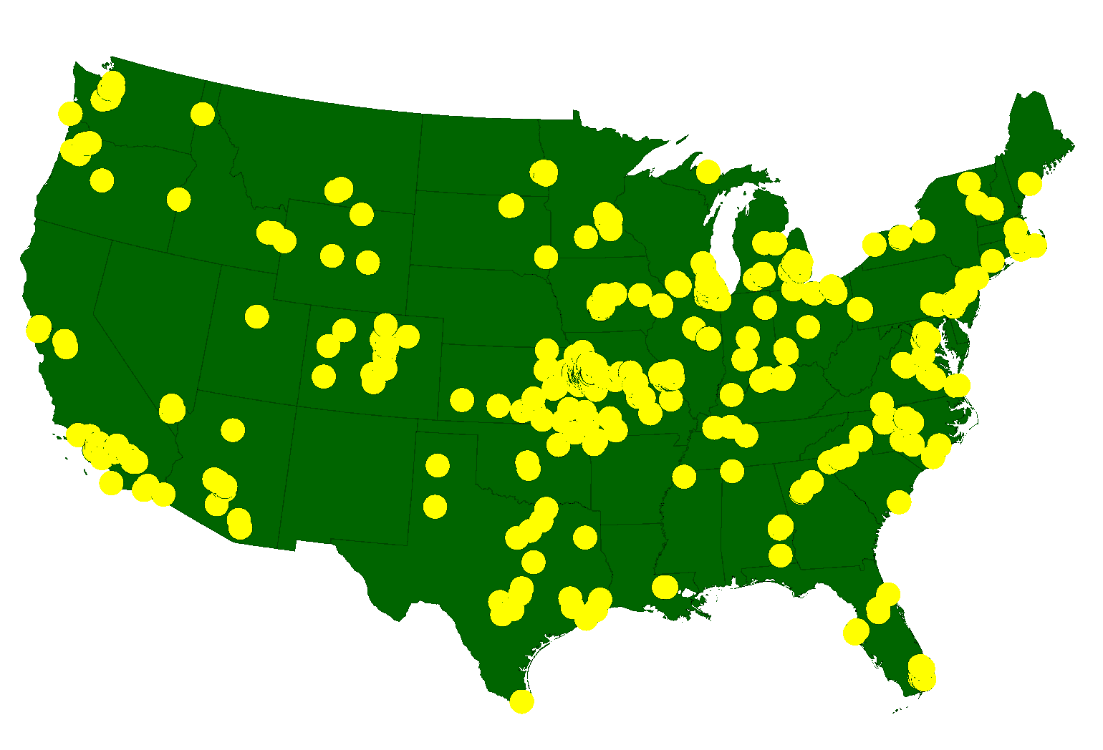
ETC Institute
A National Leader in Market Research
for Local Governmental Organizations
…helping city and county governments gather and use survey data to enhance organizational performance for more than 30 years
More than 2,150,000 Persons Surveyed Since 2007
for more than 900 cities in 49 States

Slide 3
Agenda
Purpose and Methodology
Bottom Line Upfront
Major Findings
2
Summary
Questions

Slide 4
Purpose
To objectively assess citizen satisfaction with the delivery of City services
To compare the City’s performance with residents in other communities
To measure trends from previous surveys
To help determine priorities for the community

Slide 5
Methodology
Survey Description
  seven-page survey; asked many of the same questions from previous surveys
  3rd community survey administered for the City
Method of Administration
  by mail, online and phone to a random sample of City residents
  each survey took approximately 15-20 minutes to complete
Sample size:
  goal number of surveys: 400
  goal far exceeded: 872 completed surveys
  demographics of survey respondents accurately reflects the actual population of the City
Confidence level: 95%
Margin of error: +/- 3.3% overall

Slide 6
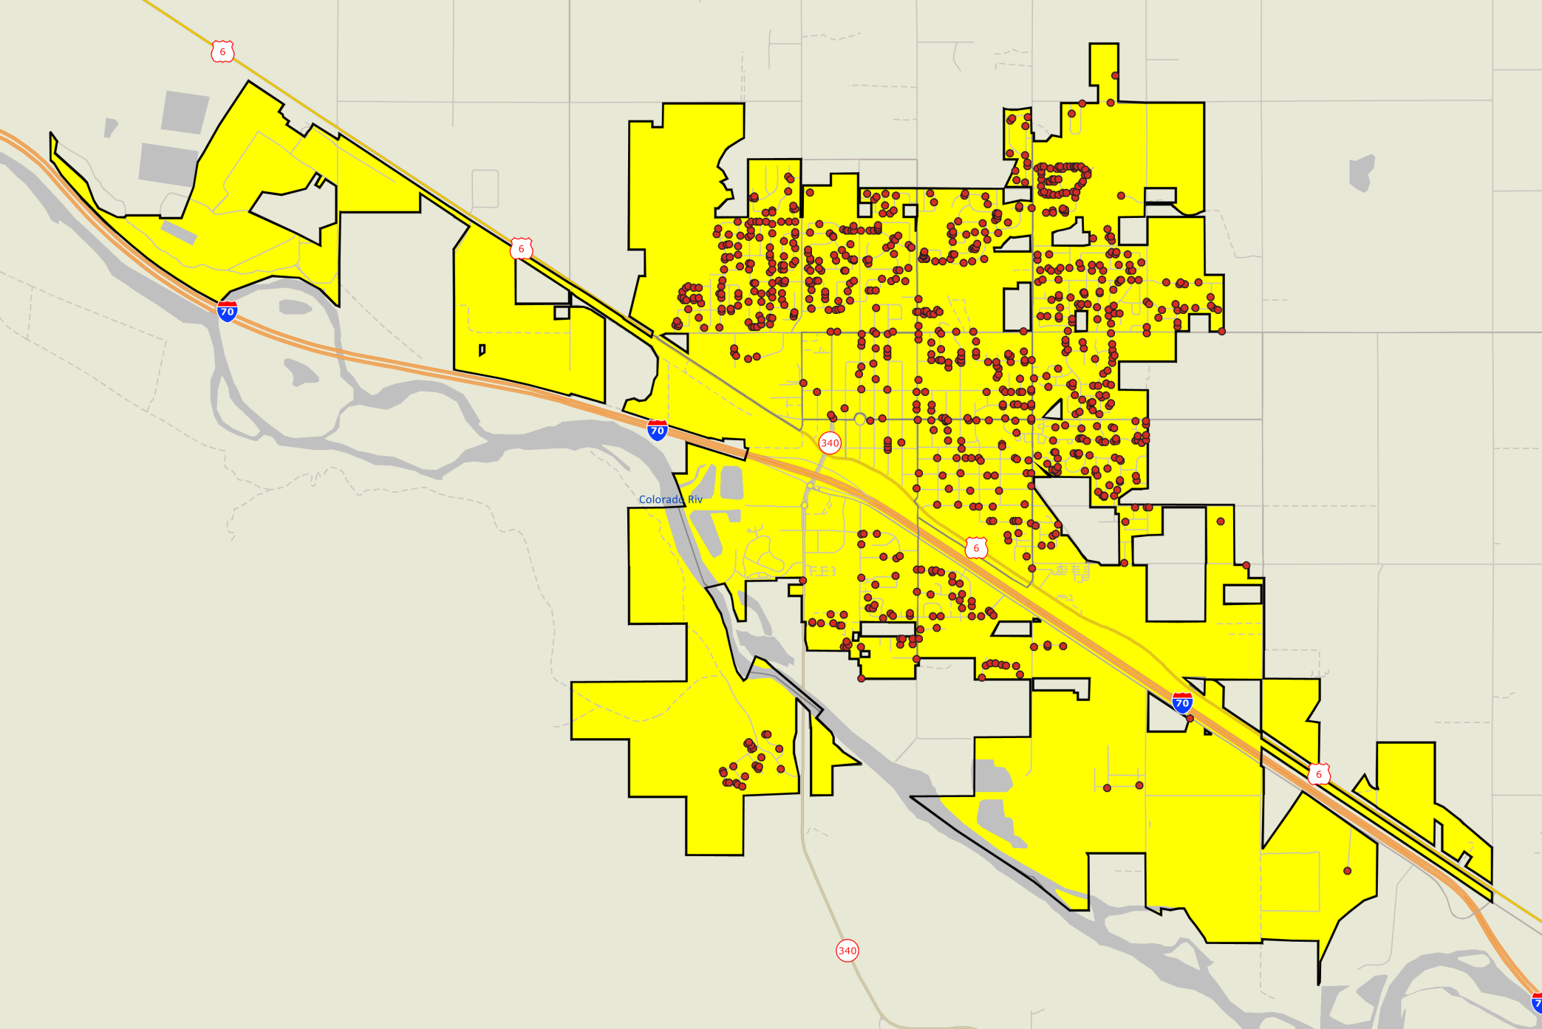

Location of Survey Respondents
Good representation throughout the City
City of Fruita 2017 Community Survey

Slide 7
Bottom Line Up Front
Residents Have a Very Positive Perception of the City
    95% rated the overall quality of life in Fruita as “excellent” or “good”
    84% rated the overall quality services provided by the City of Fruita as “excellent” or “good”
The City Is Moving in the Right Direction
  Satisfaction ratings have increased in 46 of 59 areas since 2013, and increased in 37 of 45 areas since 2009
Satisfaction with City Services Is Much Higher in Fruita Than Other Communities
  Fruita rated above the U.S. Average in 31 of 36 areas, and above the average for small U.S. cities in 32 of 36 areas
  Satisfaction with the Overall Quality of City Services rated 35% above the U.S. Average, and 37% above the average for small U.S. cities
Top Overall Priorities:
  Quality of City streets
  Effectiveness of City communication with the public
  Flow of traffic and congestion management

Slide 8
Topic #1
Residents Have a Very Positive Perception of the City

Slide 9
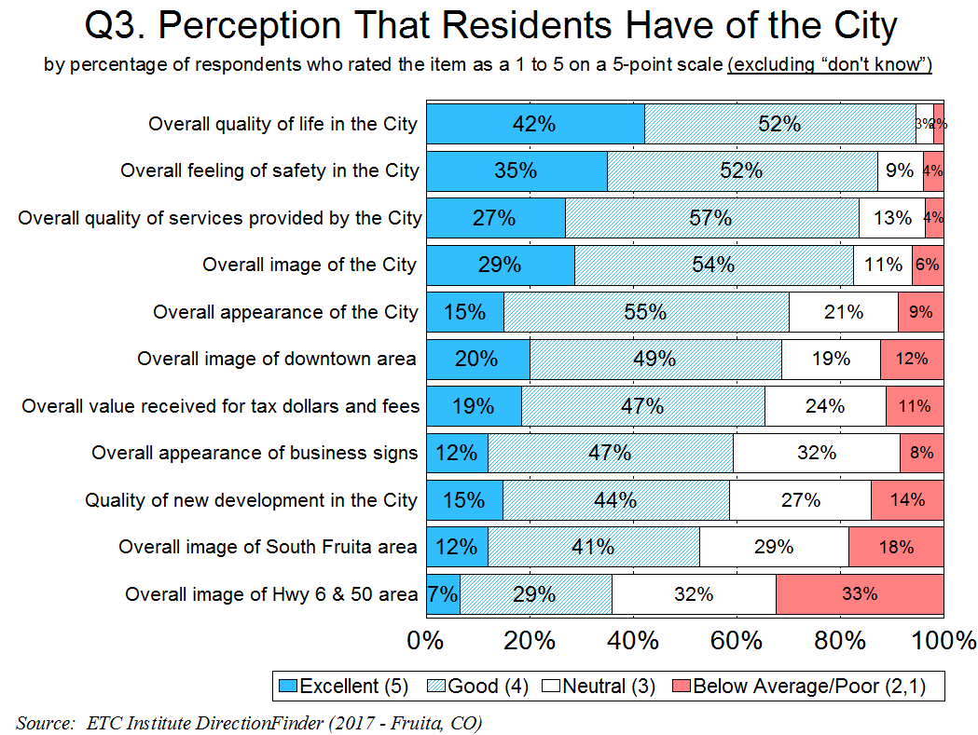
84% of Residents Rated the Overall Quality of City Services as “Excellent” or “Good”; Only 4% Gave a Rating of “Below Average” or “Poor”
9

Slide 10
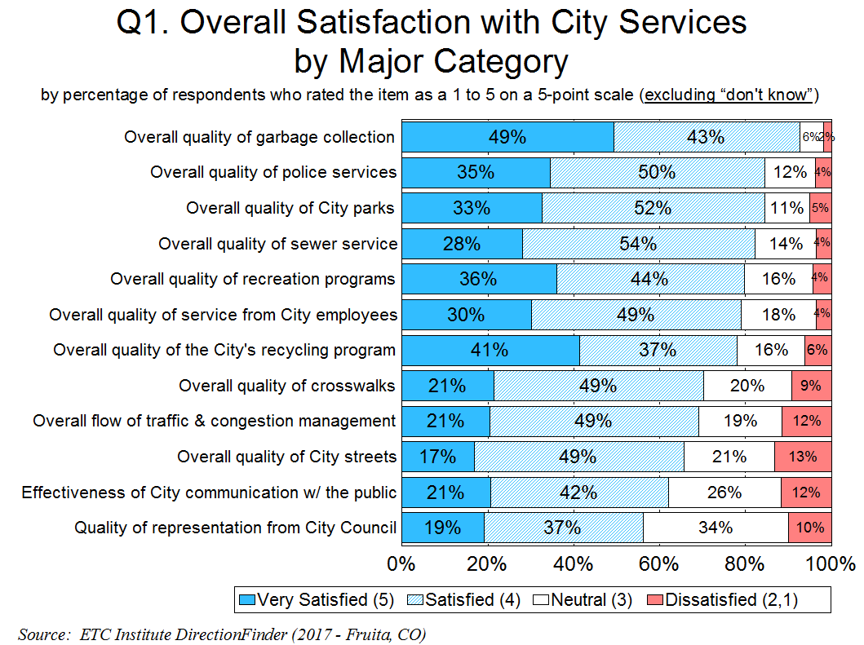
10
Less 15% Were Dissatisfied with All City Services

Slide 11
Topic #2
The City Is Moving in the Right Direction

Slide 12
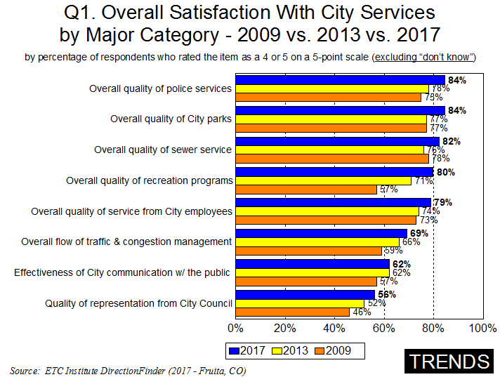
Significant Increase from 2013: Significant Decrease from 2013:
12

Slide 13
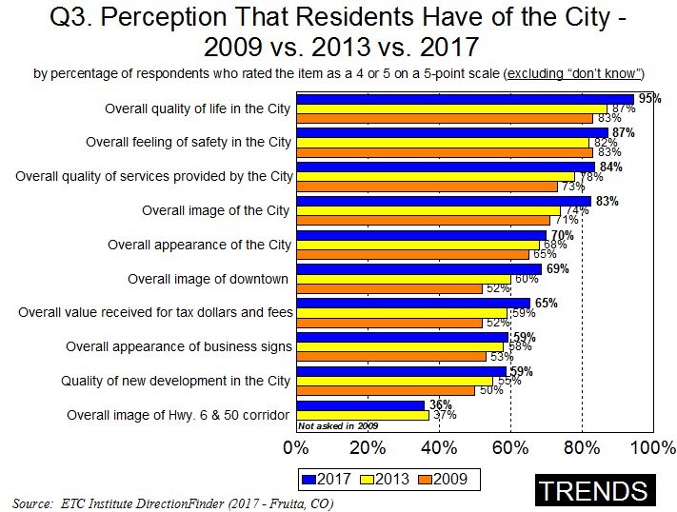
Significant Increase from 2013: Significant Decrease from 2013:
13

Slide 14
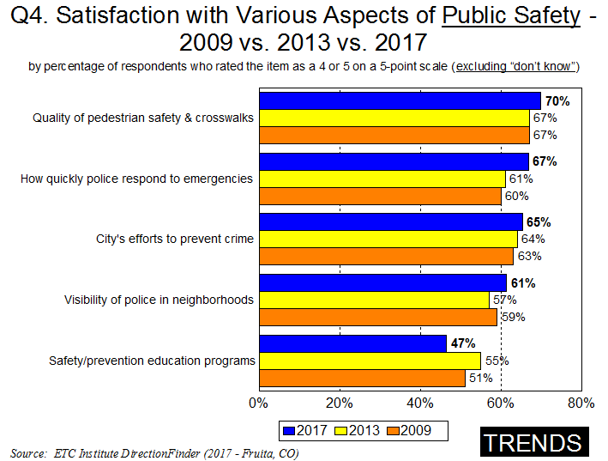
Significant Increase from 2013: Significant Decrease from 2013:
14

Slide 15
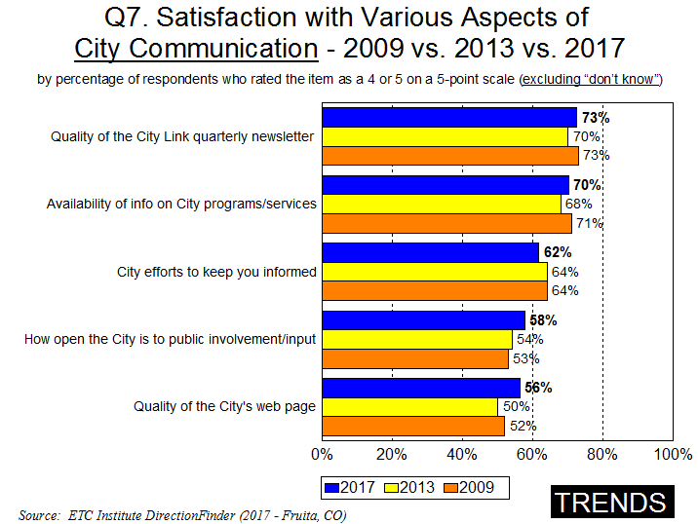
Significant Increase from 2013: Significant Decrease from 2013:
15

Slide 16
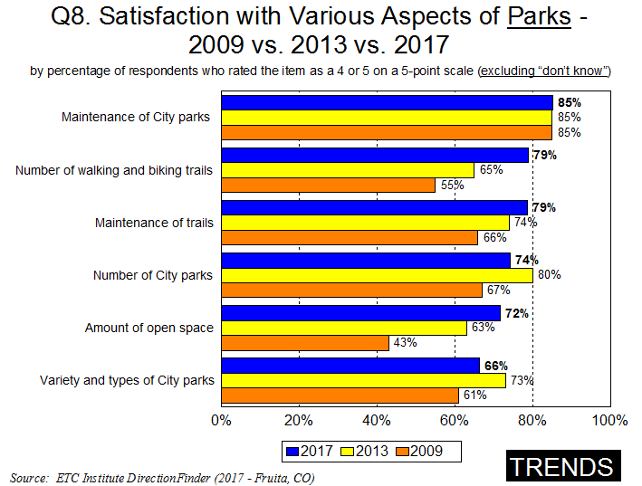
Significant Increase from 2013: Significant Decrease from 2013:
16

Slide 17
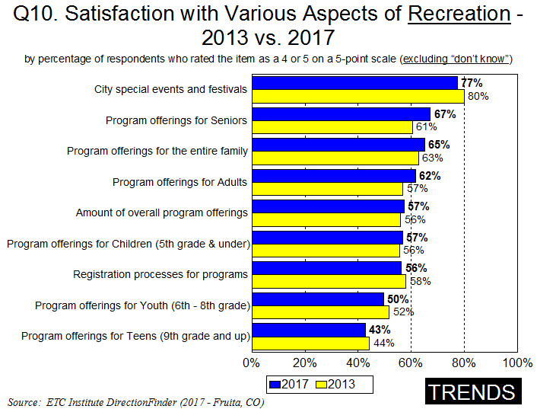
Significant Increase from 2013: Significant Decrease from 2013:
17

Slide 18
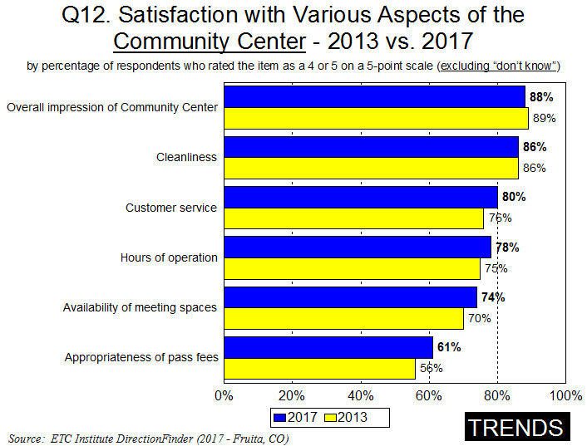
Significant Increase from 2013: Significant Decrease from 2013:
18

Slide 19
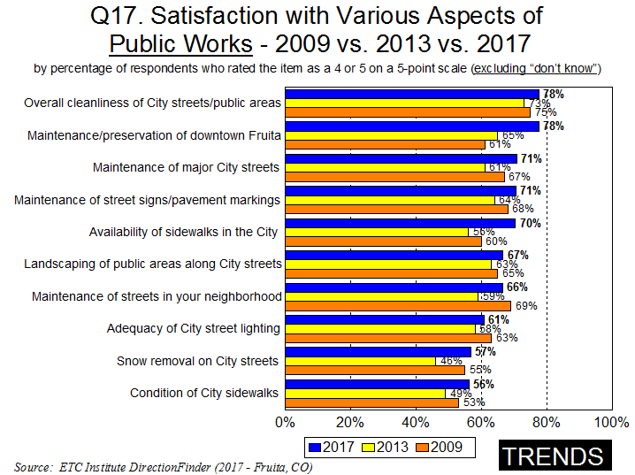
Significant Increase from 2013: Significant Decrease from 2013:
19

Slide 20
Topic #3
Satisfaction with City Services Is Much Higher in Fruita Than in Other Communities

Slide 21
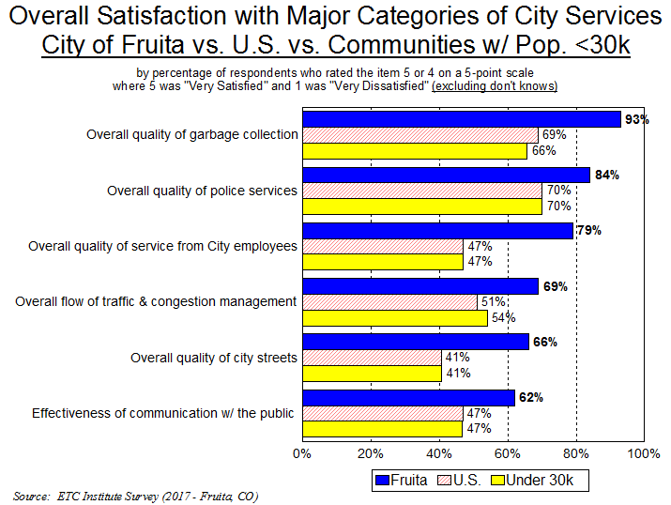
21
Significantly Higher: Significantly Lower:

Slide 22
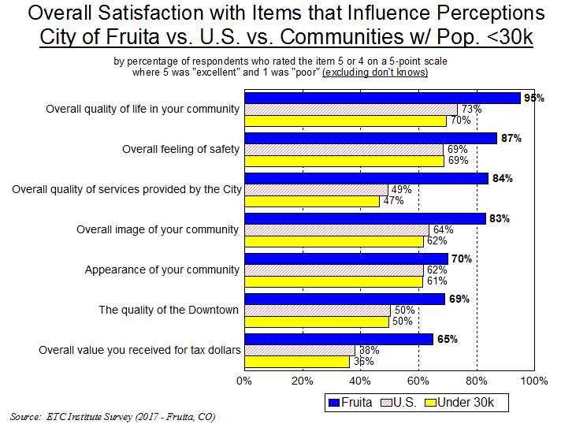
22
Significantly Higher: Significantly Lower:

Slide 23
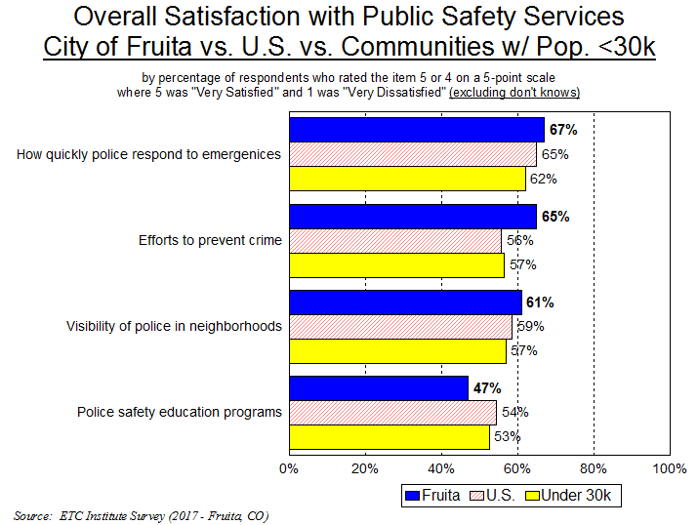
23
Significantly Higher: Significantly Lower:

Slide 24
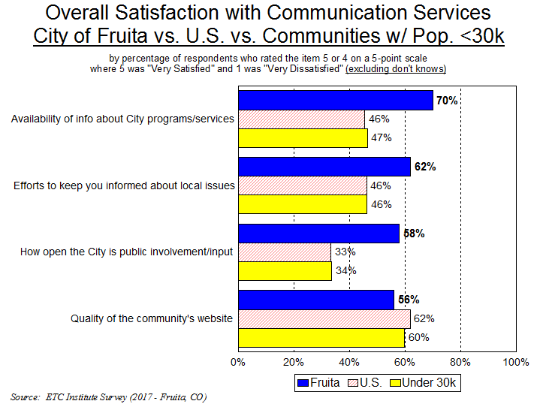
24
Significantly Higher: Significantly Lower:

Slide 25
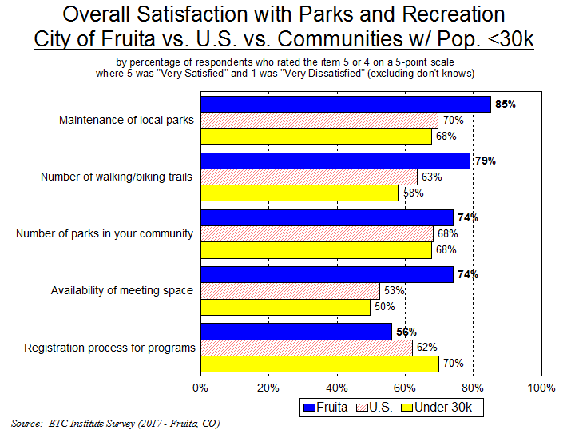
25
Significantly Higher: Significantly Lower:

Slide 26
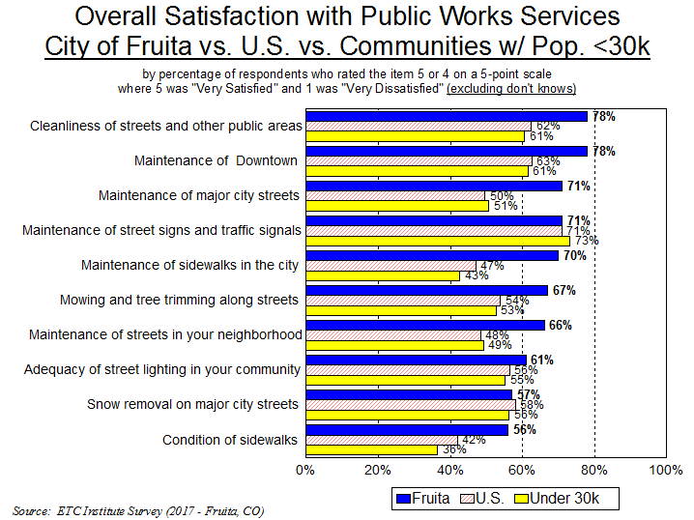
26
Significantly Higher: Significantly Lower:

Slide 27
Topic #4
Top Priorities

Slide 28
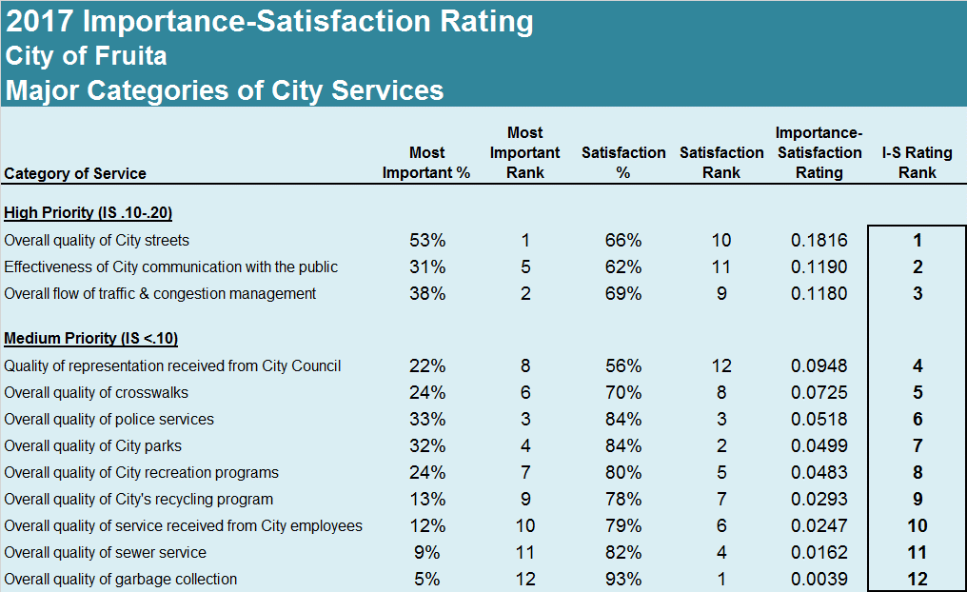
Top Priorities:
28

Slide 29
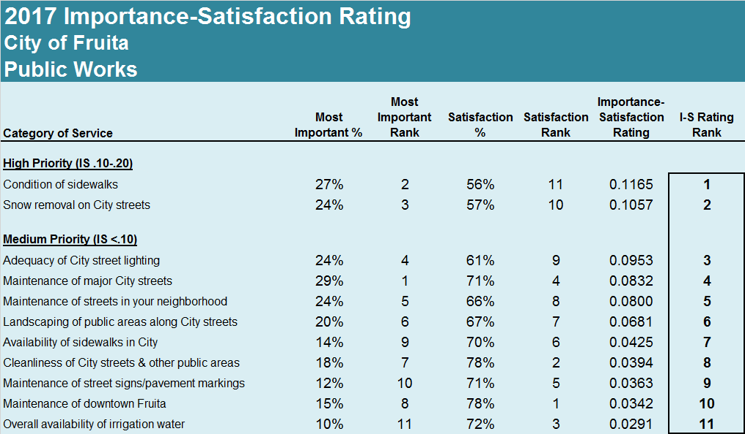
Public Works Priorities:
29

Slide 30
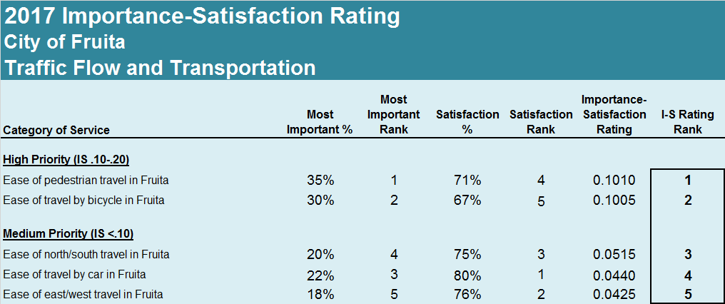
Traffic Flow and Transportation Priorities:
30

Slide 31
Topic #5
Health Care Services

Slide 32
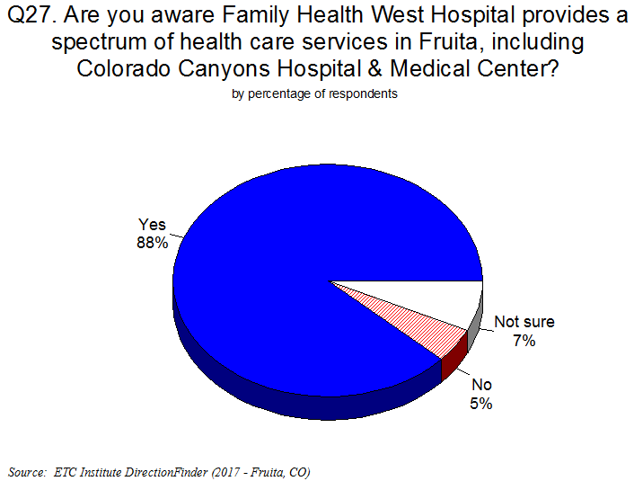
32

Slide 33
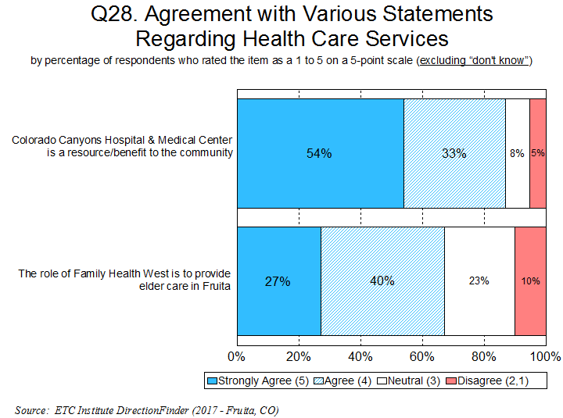
87% Feel That Colorado Canyons Hospital & Medical Center Is a Resource/Benefit to the Community
33

Slide 34
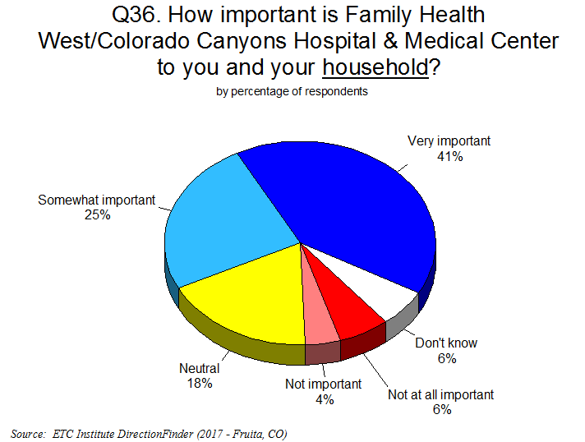
66% Feel Family Health West/Colorado Canyons Hospital & Medical Center Is Important to Their Household; Only 10% Feel It’s Not Important
34

Slide 35
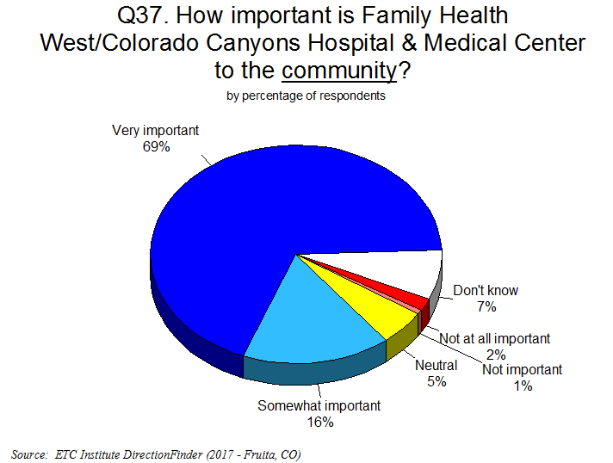
85% Feel Family Health West/Colorado Canyons Hospital & Medical Center Is Important to the Community; Only 3% Feel It’s Not Important
35

Slide 36
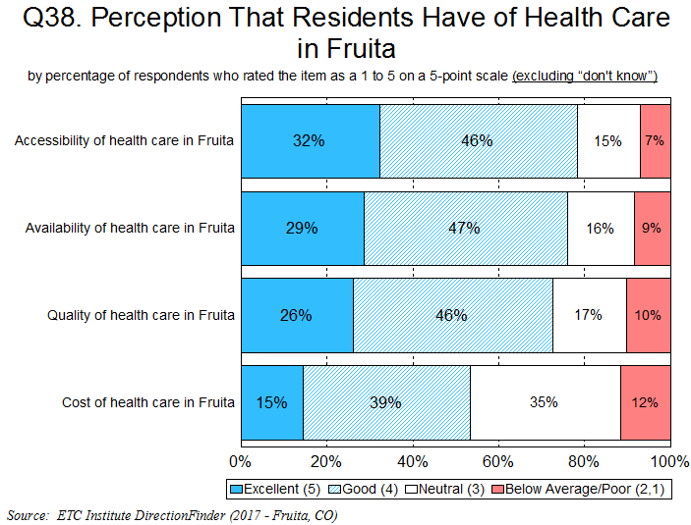
Over 75% Rated the Accessibility and Availability of Health Care in Fruita as
“Excellent” or “Good”; Less Than 10% Rated Them as “Below Average” or “Poor”
36

Slide 37
Other Findings

Slide 38
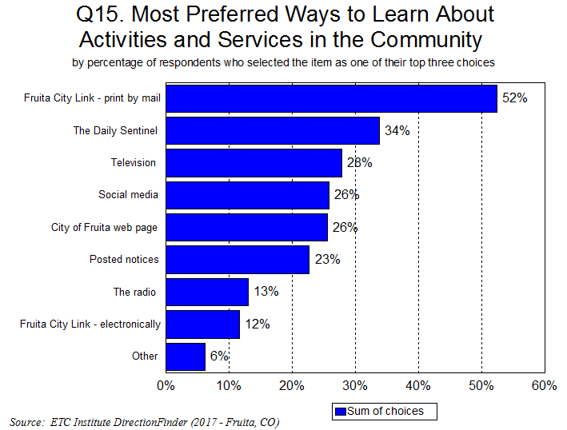
38

Slide 39
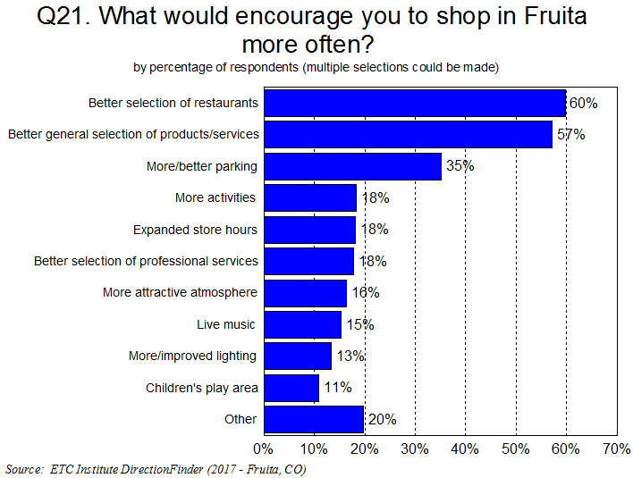
39

Slide 40
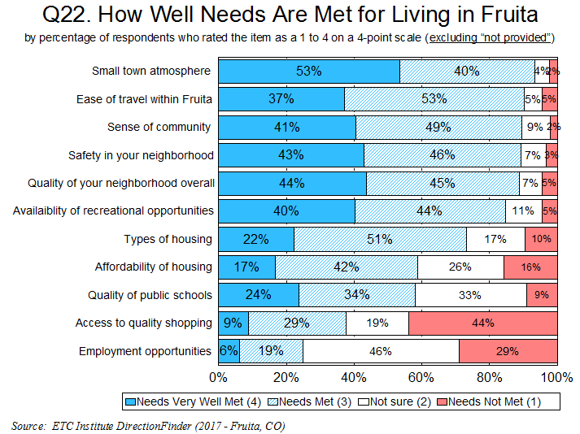
40

Slide 41
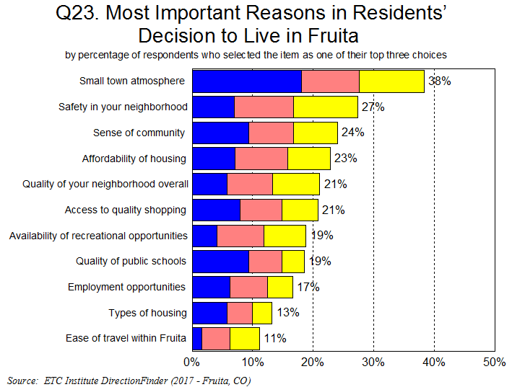
41

Slide 42
Summary
Residents Have a Very Positive Perception of the City
    95% rated the overall quality of life in Fruita as “excellent” or “good”
    84% rated the overall quality services provided by the City of Fruita as “excellent” or “good”
The City Is Moving in the Right Direction
  Satisfaction ratings have increased in 46 of 59 areas since 2013, and increased in 37 of 45 areas since 2009
Satisfaction with City Services Is Much Higher in Fruita Than Other Communities
  Fruita rated above the U.S. Average in 31 of 36 areas, and above the average for small U.S. cities in 32 of 36 areas
  Satisfaction with the Overall Quality of City Services rated 35% above the U.S. Average, and 37% above the average for small U.S. cities
Top Overall Priorities:
  Quality of City streets
  Effectiveness of City communication with the public
  Flow of traffic and congestion management

Slide 43
Questions?
THANK YOU!!

